Slide 1

How Has AI Affected Unemployment?
Key Considerations: Job Displacement, Creation, Skills Gap, and Productivity Gains.

Slide 2


Meet the Team
Xavier
Jessica
Samandar
Data Collection and Analysis
Data Collection and Analysis
Data Cleaning & Presentation

Slide 3

What Inspired This Project
AI Integration in Workplaces
The increasing adoption of Artificial Intelligence (AI) across various professional environments.
Job Displacement Concerns
Growing anxieties about the potential for AI to replace human jobs.
Empirical Impact Analysis
A drive to move beyond assumptions and scientifically assess AI's actual effects on employment.
Notes:
xavi

Slide 4

Presentation Objectives
Employment Comparison
Compare employment trends issued from the Bureau of Labor Statistics to that reported from companies spanning from 2014 to 2024.
Job Trend Analysis
Analyze emerging job market trends.
AI Impact Study
The impact of Artificial Intelligence on employment.
Understand Job Changes
Understand the nature and extent of changes in the job market.
Notes:
xavi

Slide 5

AI's Impact on Work and Learning
The Significance of AI In The Workforce
Transforming Workplaces: AI is automating basic tasks, enhancing productivity, and creating new avenues for innovation across industries.
Strategic Advantage for Companies: AI enables data- driven decision making, optimizes operations, and drives strategic planning for evolving job trends.
Demonstrating Real-World Impact: From healthcare advancements to classroom aid, AI's benefits are increasing and driving progress by solving complex global challenges.
Notes:
jess

Slide 6
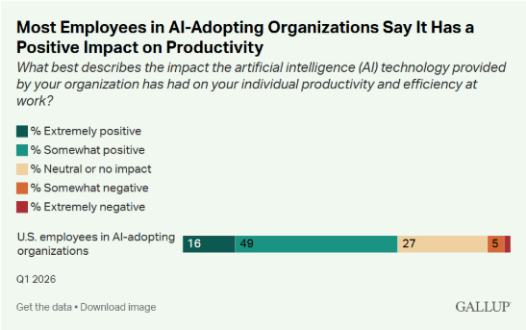
AI Users Report Productivity Gains but
Rarely Transformational Changes to Work
Within organizations implementing AI, 65% of employees say artificial intelligence has improved their productivity and efficiency, regardless of how often they personally use AI.
16% say the effect has been positive.
< 1% say AI has a negative impact on their work.
Notes:
xavi

Slide 7

Selected Job Sectors Description
Software Publishers
Focusing on innovation and digital transformation.
Management of Companies and Enterprises
Addressing market trends and strategic growth.
Elementary and Secondary Schools
Enhancing learning experiences and developing skills.
Construction
Building and developing infrastructure projects.
Medical Equipment & Supplies Manufacturing
Advancing healthcare and wellness solutions.
Administrative and Support Services
Optimizing operations and management processes.
Notes:
sam

Slide 8




Project Roadmap
Key phases of our data analysis project
Collect Data
Clean Data
Analyze Trends
Interpret Results
Labor statistics provided by BLS.
Research largest publicly traded companies within the respective industries.
Isolating relevant data from BLS data.
Identify trends over time as AI’s implementation has increased.
Drawing conclusions and correlations between job trends and the rise of AI implementation in the job sector.
Notes:
sam

Slide 9

Challenges
Inconsistent data
Data points from different sources frequently do not align or follow a standard format, making analysis comparison difficult.
Missing AI information
Key details regarding Artificial Intelligence components, such as models or capabilities, are often absent from reports.
Hard to link AI to jobs
Establishing a concrete connection between AI applications and specific job roles or requirements proves challenging.
Notes:
jess

Slide 10


Data and Tools
Excel / Google Sheets
Google Gemini
Industry Data
Codex: Cloud Coding Agent
Spreadsheet for data organization and analysis.
AI-powered tool for data set trimming and code debugging.
Relevant datasets specific to the industry for comparison.
Run Statistical Analysis on BLS data.
Notes:
sam

Slide 11





Methodology
Our Systematic Approach
Collect
Clean
Identify AI
Compare
Analyze
Gathering all relevant data and information.
Preprocessing and refining the collected data for accuracy and consistency.
Pinpointing or integrating Artificial Intelligence components or insights.
Evaluating different data points or findings against each other.
Interpreting the processed data to derive meaningful conclusions.
Notes:
jess

Slide 12
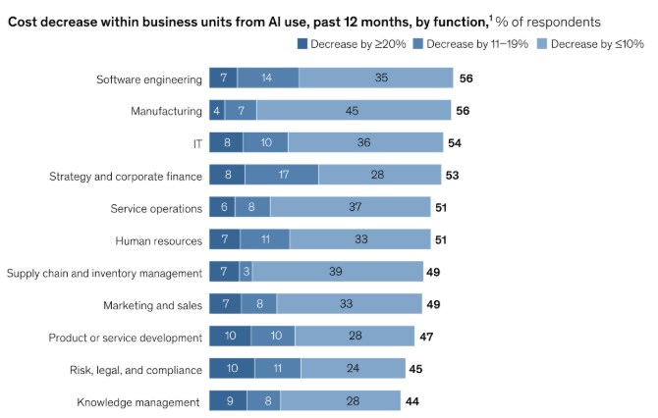
Results from McKinsey graphs
Impact on the Job Market
Tech Jobs Increased
Significant growth observed in technology-related employment sectors.
Routine Jobs Decreased
A notable decline in positions primarily involving repetitive tasks.
AI Supports Skilled Work
Artificial intelligence is augmenting and enhancing the capabilities of skilled professionals.
Notes:
xavi

Slide 13
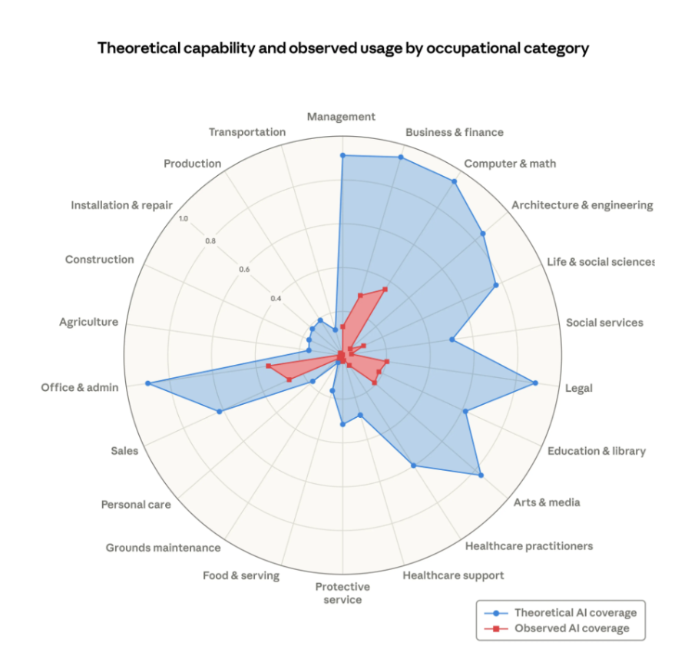
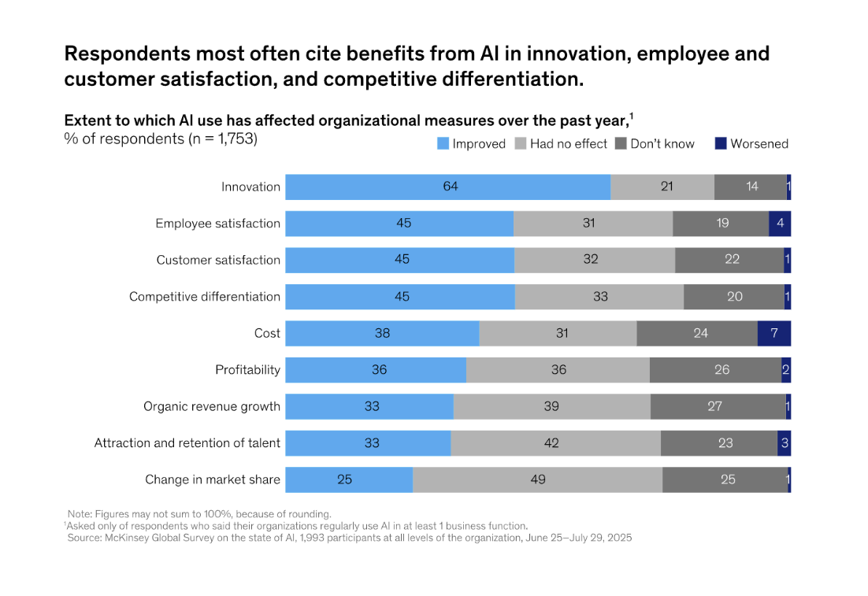
Sector Comparison Analysis
Analyze the trends across sectors to identify commonalities and divergences.
Notes:
xavi

Slide 14
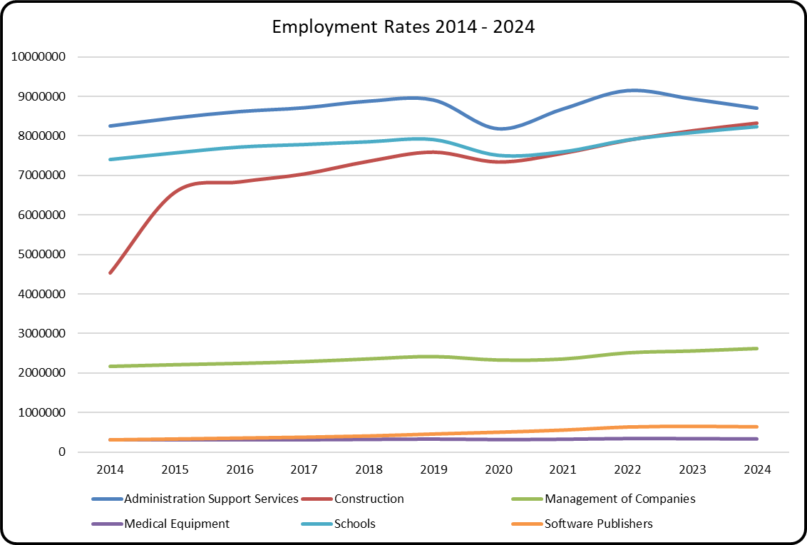
Employment Rates by Sector, 2014-2024
United States Bureau of Labor Statistics.
Values represent total employment by sector for each year.
The change of employment from 2014 to 2024.
Notes:
jess

Slide 15
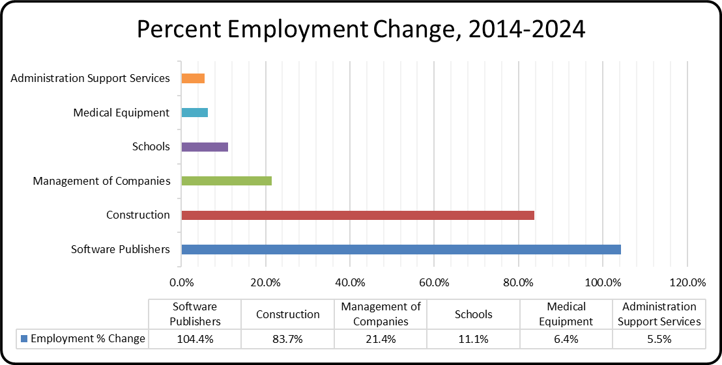
Percent Employment Change by Sector, 2014-2024
Software Publishers experienced the highest growth at 104.4% rate.
Construction followed with strong growth at a rate of 83.7%.
Management of Companies showed moderate growth at 21.4% rate.
Schools, Medical Equipment, and Administration Support Services grew at a slower rate.
The results show a positive trend in employment growth across all sectors.
A net change of employment from 2014 to 2024.
Notes:
jess

Slide 16
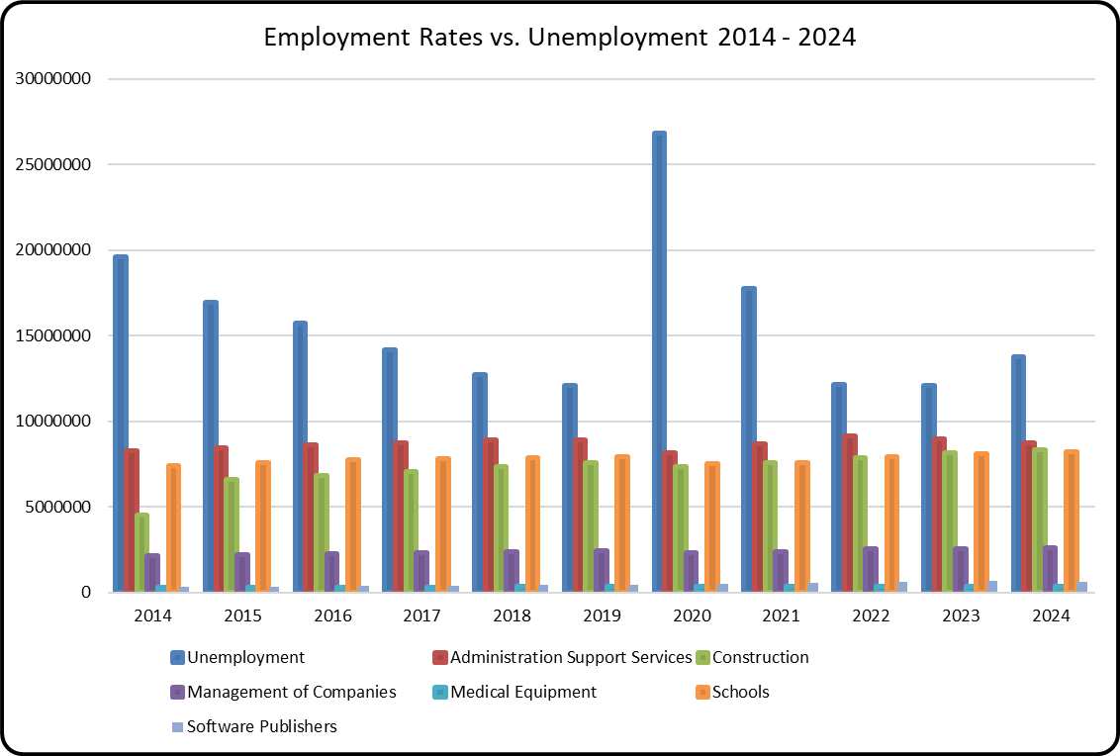
Employment Rates vs Unemployment Rate, 2014-2024
United States Bureau of Labor Statistics.
Values represent total employment by sector for each year.
The rate of employment compared to the national unemployment rate from 2014 to 2024.
Notes:
jess

Slide 17
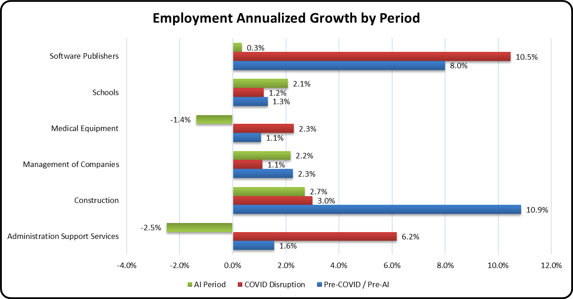
Employment Annualized Growth by Sector and Period
Pre-Covid/ Pre-AI
2014 - 2019
Covid Disruption
2020-2021
AI Period
2022 - 2024
Change of employment during different time blocks through 2014-2024.
Notes:
sam

Slide 18

Interpretation
AI's Impact on Work
Artificial intelligence implementation is fundamentally changing the nature of job roles and responsibilities.
Skill Acquisition
This transformation requires individuals to develop and acquire new skills and levels competency.
Adapting Education
Educational systems need to evolve to effectively address these changing demands to better prepare students for the changing job market.
Notes:
sam

Slide 19



Key Findings on AI's Impact on Employment
Job Creation & Displacement
Mixed Hiring Patterns
Variable Impact Across Sectors
AI technologies are creating new job opportunities while automating existing roles, leading to a dynamic shift in labor demands.
Organizations observe varied hiring trends, with increased demand for AI skills in some sectors with a surplus or deficit in others.
The impact of AI on employment is not uniform, varying significantly by industry, job function, required skills, and adoption pace.
Notes:
sam

Slide 20

AI's Impact on the Job Market
Job Decline
Certain roles may diminish due to automation.
Job Growth
New opportunities will emerge, driven by AI development and integration.
Adaptation is Key
Continuous learning and skill development are crucial for navigating these shifts.
AI's impact on the job market is multifaceted, involving both job decline and growth. Adaptation through continuous learning and skill development is crucial.
Notes:
jess

Slide 21

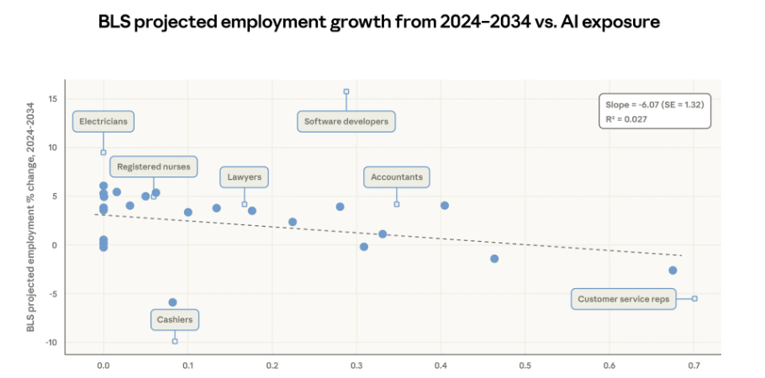

Future Work
Develop Future Predictions
Build more sophisticated models for forecasting future trends and outcomes.
Enhance Data Quality
Improve the accuracy, completeness, and relevance of the underlying data.
Expand to More Industries
Incorporate insights and applications for a wider range of industries.
Notes:
xavi

Slide 22

Any questions?

